Slide 1
World Happiness Report

Slide 2
Project Background
Problem: The World Happiness Report is a survey of the state of global happiness among nations. The 2017 update ranks 155 countries by their happiness level, which is effected by six factors.
Hypothesis: Among the six key factors, life expectancy and GDP per capita are weighted heavier than other features when it comes to determining happiness score.
Goal: Build and train statistical model to predict the happiness score of a country.

Slide 3
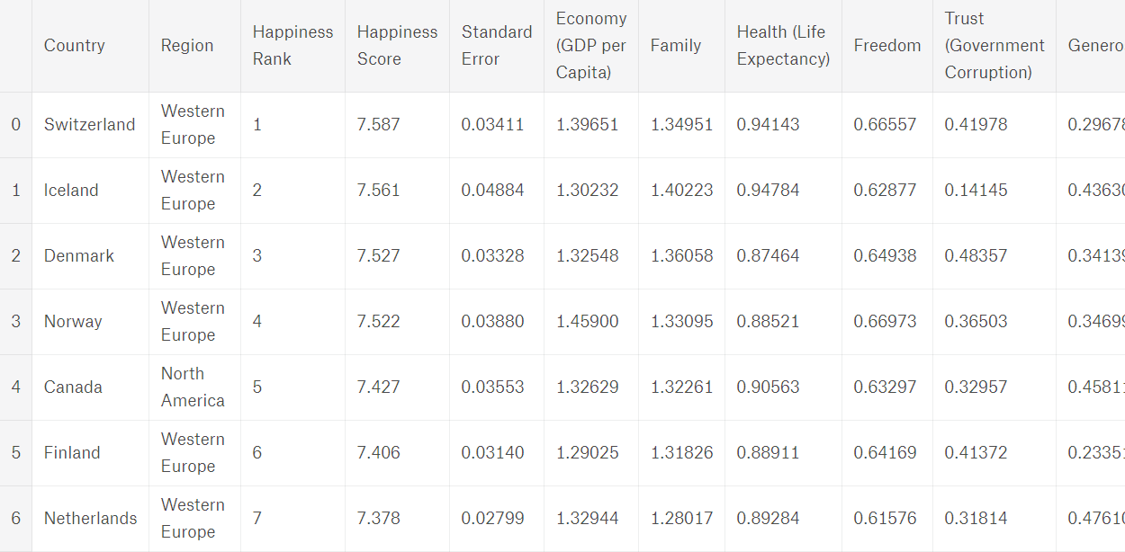
Data Overview
Data Source: https://www.kaggle.com/unsdsn/world-happiness
Data comes in 3 separate sets from 3 years: 2015, 2016, and 2017
Depends on the year dataset there are minor differences, all data sets contain 8 main features and 155 rows representing 155 countries. The main features are: Country, Rank, Happiness Score, Economy (GDP per capita), Family (social support), Health (life expectancy), Freedom, Trust (Government Corruption), Generosity, and Dystopia Residual
Dystopia- the happiness score of the country Dystopia is 1.85, it is set up as a baseline metric/ benchmark which all countries can be favorably compared in terms of each of the six key variables.
Residuals – are unexplained component, differ for each country, that effect overall happiness score.

Slide 4
E-Commerce Activity from Actual Online Retailer

Slide 5
Project Background
Problem: A non-proprietary data set of actual e-commerce transactions from 2010 to 2011. The data come from a UK-based non-store online retail that ships globally.
Hypothesis: Order size (quantity) has a positive correlation with whether a customer is a returned customer from 2010.
Goal: Develop a model that allows to anticipate the purchases made by a new customer, during the following year and this, from its first purchase.

Slide 6
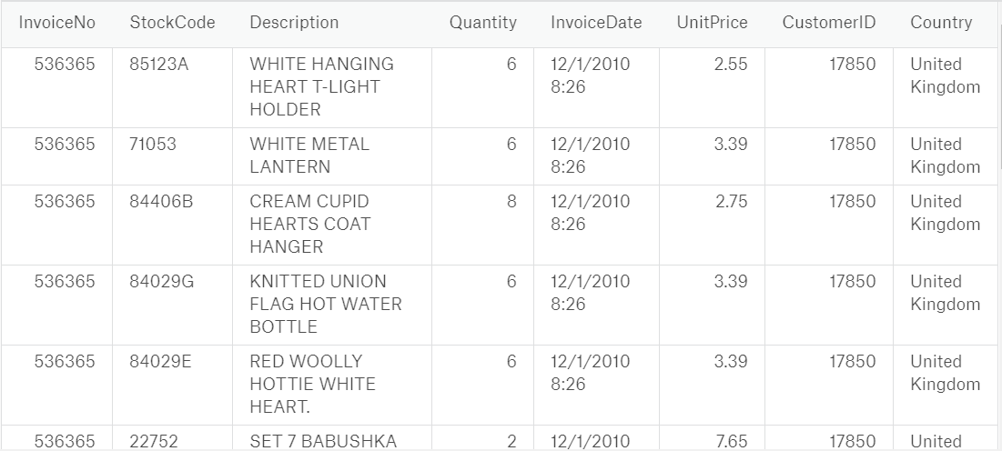
Data Overview
Data Source: https://www.kaggle.com/carrie1/ecommerce-data/data , made available by Dr Daqing Chen, Director: Public Analytics group. chend '@' lsbu.ac.uk, School of Engineering, London South Bank University, London SE1 0AA, UK.
The database contain 8 main features and 541910 rows of individual transactions. The main features are: InvoiceNo, StockCode, Description, Quantity, InvoiceDate, UnitPrice, CustomerID, Country. Data time frame is Jan 12, 2010 – Sept 12, 2011. There are around 4,000 customers in this database, identified by CustomerID.

Slide 7
Data Dictionary
This dataframe contains 8 variables that correspond to:
InvoiceNo: Invoice number. Nominal, a 6-digit integral number uniquely assigned to each transaction. If this code starts with letter 'c', it indicates a cancellation. StockCode: Product (item) code. Nominal, a 5-digit integral number uniquely assigned to each distinct product. Description: Product (item) name. Nominal. Quantity: The quantities of each product (item) per transaction. Numeric. InvoiceDate: Invice Date and time. Numeric, the day and time when each transaction was generated. UnitPrice: Unit price. Numeric, Product price per unit in sterling. CustomerID: Customer number. Nominal, a 5-digit integral number uniquely assigned to each customer. Country: Country name. Nominal, the name of the country where each customer resides.

Slide 8
Titanic Shipwreck

Slide 9
Project Background
Problem: predict survivability of passenger from the Titanic shipwreck incident
Hypothesis: Sex and Age are better predictor to survivability than other variables such as pclass or fare
Goal: Predict which factors are related to survivability. The context for this question is some clusters of personnel tend to have lower survivability than others.

Slide 10
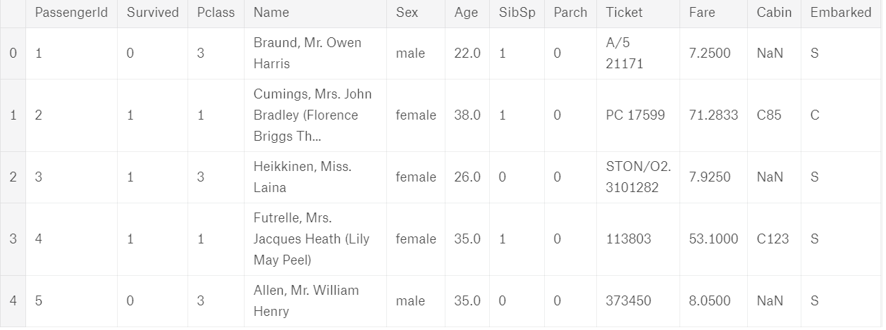
Data Overview
Data Source: https://www.kaggle.com/c/titanic/data
Data has been split into two groups: training and test set.
Data includes 11 features, 419 rows. Included some of the following categories:
PassengerId, Survived, Pclass, Name, Sex, Age, etc.
Feature engineering might be required to create additional features (ex. Pclass_Cabin)

